Slide 1
MAST30013 Group Project
Power Optimisation in Wireless Sensor Networks
Dario Latina
Michael Le (998211)
Rushaa Atawoo
Vaia Papadopoulos 994759
Notes:
Remember only 5 min presentation

Slide 2
Contents
(My task)
Introduction
Background
Theory

Slide 3
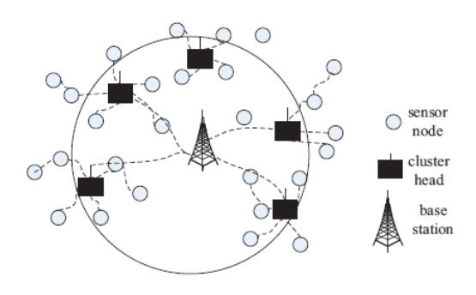
Introduction
Wireless sensor networks (WSNs) are autonomous systems that measure physical or environmental conditions such as temperature, sound, vibration, pressure, motion or pollutants to cooperatively pass their data along the network. Consists hundreds of thousands of sensor nodes which can communicate with one another through radio signals. Each sensor transmits information to a central relay which aggregates the local sensed data before transmitting it to a base station for processing. There are limitations that can occur due to processing speed, storage capacity, and communication bandwidth. Used as common resource on constrained problems through STEM research.
Figure 1. Wireless sensor network setup

Slide 4
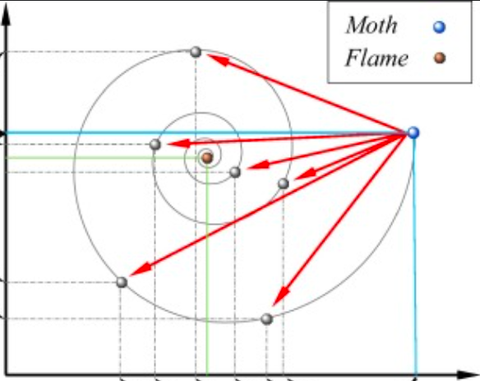
Background
Many optimisation techniques look at optimising the position of relay nodes, the number of relay nodes, and modulation sizes. Understanding the positioning of relay nodes to ensure full connectivity of the network. Nature inspired optimisation algorithms have been used to update the relay node positions iteratively to achieve the best possible global position. Here are some examples of different algorithms below,
Moth Flame Optimisation (MFO) Sayedali Mirjalili (2015)
A population-based algorithm that looks at the movement of moths when attracted to light sources. The key element is in the way the moths update their position around the light source gets better. Depending on the position of the moth is updated as every moth tries to find a better position. Thus, allows to improve a better solution.
Interior Search Algorithm (ISA)
A. Gondomi (2014)
Figure 2. Illustration of the Moth Flame Optimisation
The process of this algorithm begins from the bounds and borders of the problem and slowly moves towards the centre. Behaves in a series of steps where research is first conducted, followed by analysing results and tailoring that knowledge into the beatification process. This was often used in practise to solve many optimization problems.

Slide 5
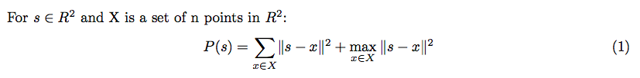

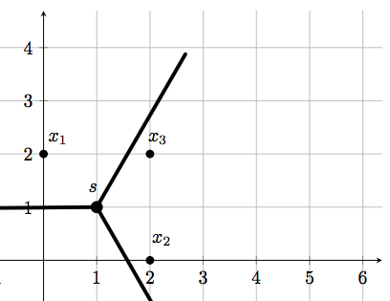
Theory Part 1
For the following problem,
We have 3 sensors in the plane, X = x1,x2,x3 located randomly around the s = (s1,s2). See Figure 3
Derving the problem from (1)
Where s is furthest away from x3 than from either x1 or x2 and take s = {1,1). As s approaches we find the limit values of the gradient,
This time s is furthest away from x1 than from either x2 or x3. Following the similar method
The limit does not exist as s = (1,1) since both limits of the gradient have different values. It is not continuous and P(s) is not differentiable hence not C1. But P(s) is convex since we have the norms, squaring a convex non negative function, pointwise max function and the sum of convex are all convex.
Figure 3. Illustration of Non-differentiable points

Slide 6
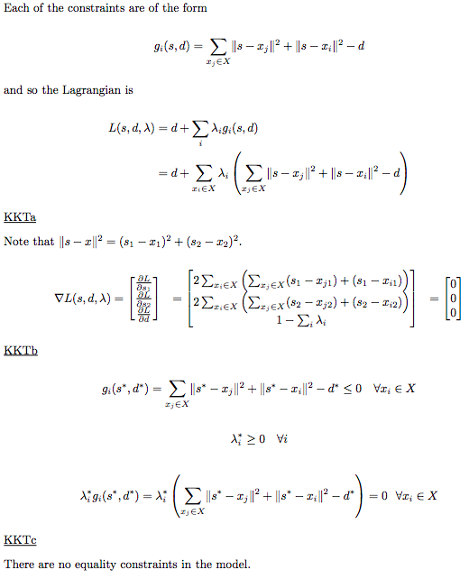




Theory Part 2
To convert P(s) into a constrained problem, Let d (is a linear upper bound and it is linear) be our new variable.
Take the max out to the front and use variable d vans deduce that the objective is C1 and smooth:
Overall, the constraint problem is still convex as we have proven in Theory Part 1.
Figure 4. KKT Conditions

Slide 7
Solution algorithm (Rushaa Atawoo)
Steps for penalty function
Steps for Fmincon (MATLAB optimisation function)
Notes:
-include comparison algorithms we chose?

Slide 8
MAST30013 Group Project
Power Optimisation in Wireless Sensor Networks
Dario Latina
Michael Le (998211)
Rushaa Atawoo
Vaia Papadopoulos 994759
Notes:
Remember only 5 min presentation

Slide 9
Contents
(My task)
Introduction
Background
Theory

Slide 10
Introduction
Wireless sensor networks (WSNs) are autonomous systems that measure physical or environmental conditions such as temperature, sound, vibration, pressure, motion or pollutants to cooperatively pass their data along the network. Consists hundreds of thousands of sensor nodes which can communicate with one another through radio signals. Each sensor transmits information to a central relay which aggregates the local sensed data before transmitting it to a base station for processing. There are limitations that can occur due to processing speed, storage capacity, and communication bandwidth. Used as common resource on constrained problems through STEM research.
Figure 1. Wireless sensor network setup

Slide 11
Background
Many optimisation techniques look at optimising the position of relay nodes, the number of relay nodes, and modulation sizes. Understanding the positioning of relay nodes to ensure full connectivity of the network. Nature inspired optimisation algorithms have been used to update the relay node positions iteratively to achieve the best possible global position. Here are some examples of different algorithms below,
Moth Flame Optimisation (MFO) Sayedali Mirjalili (2015)
A population-based algorithm that looks at the movement of moths when attracted to light sources. The key element is in the way the moths update their position around the light source gets better. Depending on the position of the moth is updated as every moth tries to find a better position. Thus, allows to improve a better solution.
Interior Search Algorithm (ISA)
A. Gondomi (2014)
Figure 2. Illustration of the Moth Flame Optimisation
The process of this algorithm begins from the bounds and borders of the problem and slowly moves towards the centre. Behaves in a series of steps where research is first conducted, followed by analysing results and tailoring that knowledge into the beatification process. This was often used in practise to solve many optimization problems.

Slide 12
Theory Part 1
For the following problem,
We have 3 sensors in the plane, X = x1,x2,x3 located randomly around the s = (s1,s2). See Figure 3
Derving the problem from (1)
Where s is furthest away from x3 than from either x1 or x2 and take s = {1,1). As s approaches we find the limit values of the gradient,
This time s is furthest away from x1 than from either x2 or x3. Following the similar method
The limit does not exist as s = (1,1) since both limits of the gradient have different values. It is not continuous and P(s) is not differentiable hence not C1. But P(s) is convex since we have the norms, squaring a convex non negative function, pointwise max function and the sum of convex are all convex.
Figure 3. Illustration of Non-differentiable points

Slide 13
Theory Part 2
To convert P(s) into a constrained problem, Let d (is a linear upper bound and it is linear) be our new variable.
Take the max out to the front and use variable d vans deduce that the objective is C1 and smooth:
Overall, the constraint problem is still convex as we have proven in Theory Part 1.
Figure 4. KKT Conditions

Slide 14
Experimental Setup Part 1 (Penalty function) (Rushaa Atawoo)
Notes:
-not sure if should include?? - since presentation is only 5 min
-keep it brief?

Slide 15
Experimental Setup Part 2 (Fmincon MATLAB optimisation problem )(Rushaa Atawoo)

Slide 16
Results
Notes:
E.g “20% faster or more accurate than other algorithms”
Include graphs
Comparison graph of performance of algorithm relative to other algorithms

Slide 17
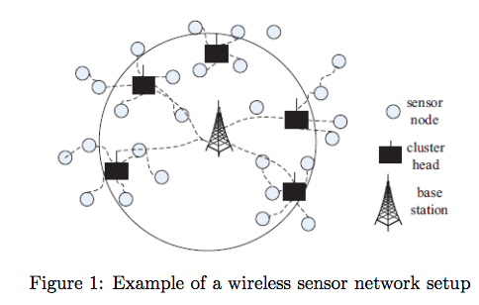
Conclusion
Notes:
-conclusion / complications?/ key findings

